Slide 1

Gwinnett County Public Schools Real-Time Bus Monitoring
Milestone 1 Presentation

Slide 2

Team 3 CS 4850 – Professor Perry

Slide 3
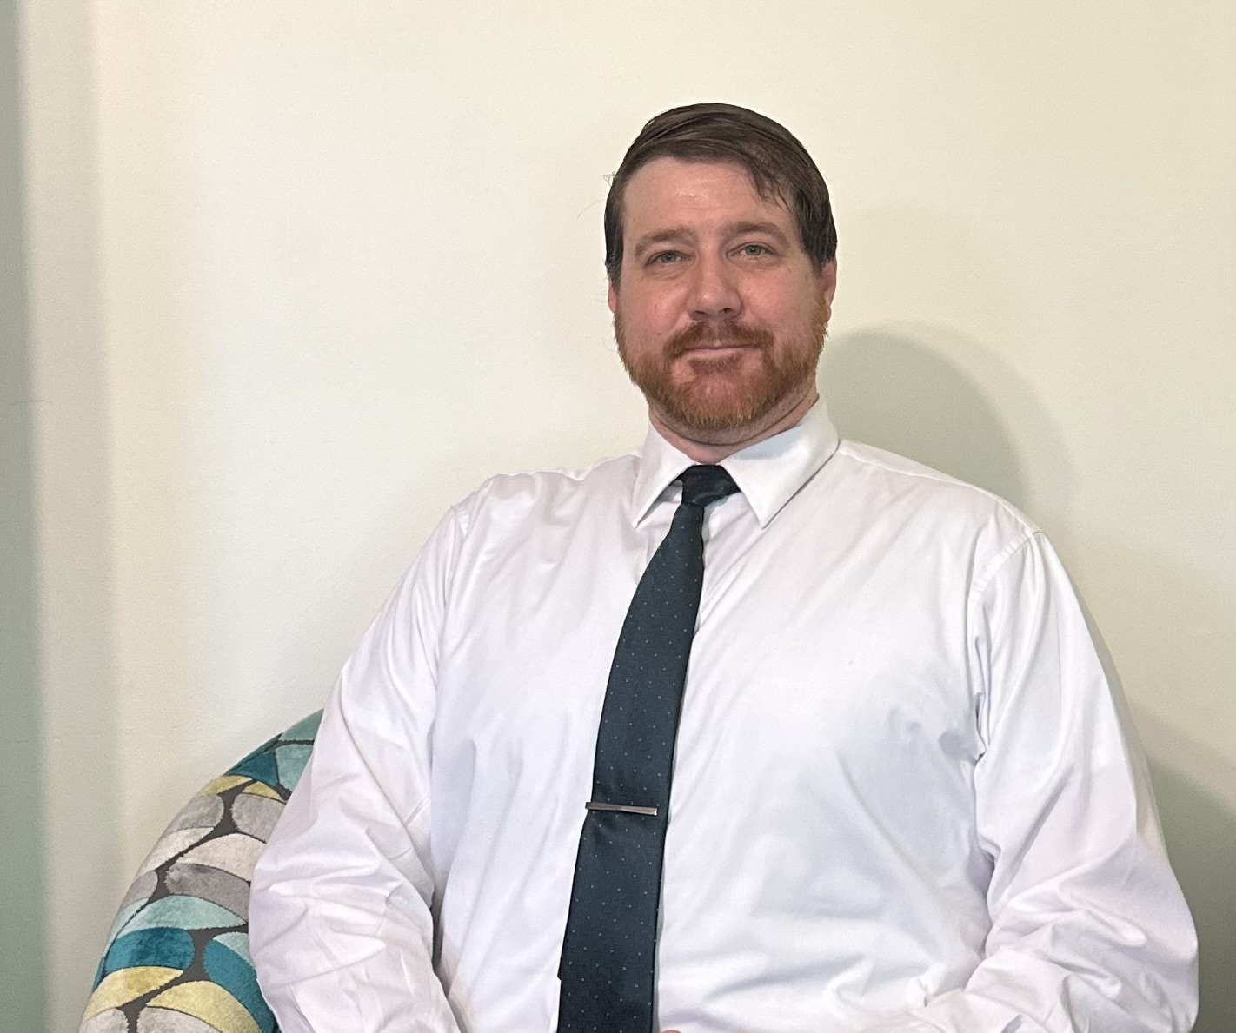
Sam Bostian
Team Role: Team Leader
Major: Computer Science
Graduation: Fall 2024
Experience:
Head Brewer at Sweeten Creek Brewing
Research Project – Parallel Processing
About me:
Enjoys woodwork and house projects
Reading Technical Books
sbostian@students.kennesaw.edu

Slide 4
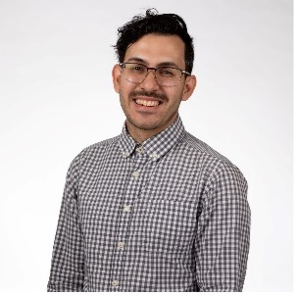
Brian Pruitt
Team Role: Documentation
Major: Computer Science
Graduation: Fall 2024
Experience:
Software Engineer Intern with The Home Depot for 3 Summers
Primarily worked with front-end React applications and GCP database solutions.
About me:
Getting married in October 2024!
Has two dogs, Ella and Nova
Part-time wedding DJ
bpruitt9@students.kennesaw.edu

Slide 5
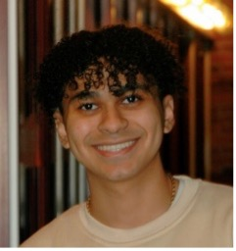
Michael Rizig
Team Role: Developer
Major: Computer Science
Graduation: Spring 2025
Experience:
Intern at Delta Community Credit Union for 2 years
About Me:
Dual Degree Program at Kennesaw State University
(BS-CS / MS-CS)
Big Fan of the Office
mrizig@students.kennesaw.edu

Slide 6
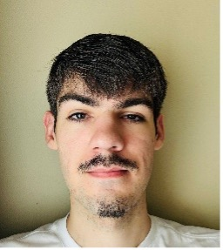
Charlie Mclarty
Team Role: Developer
Major: Computer Science
Graduation: Fall 2024
Experience:
Full Stack Developer Intern at Renmatix
Undergraduate Research Assistant Fall 2021 - Spring 2022
About Me:
Enjoys disc golf and watching football
cmclart4@students.kennesaw.edu

Slide 7

Allen roman
Team Role: Developer
Major: Computer Science
Graduation: Spring 2025
Experience:
Intern at ADP in front-end and cloud development
About Me:
Play bass in a band
Love snowboarding
aroman14@students.kennesaw.edu

Slide 8


Collaboration Tools
We use GitHub to track code changes, manage versions, and collaborate on code development.
Microsoft Office:
Document creation and project management
We use Microsoft Office tools like Word and PowerPoint for documentation, reports, and team collaboration.
Github:
Code Management and Version Control

Slide 9


Communication Tools
Microsoft Teams:
Used for formal communication, weekly meetings with stakeholders (industry), and project status updates.
Discord:
Used for day-to-day team communication, quick messaging, and informal discussions.

Slide 10
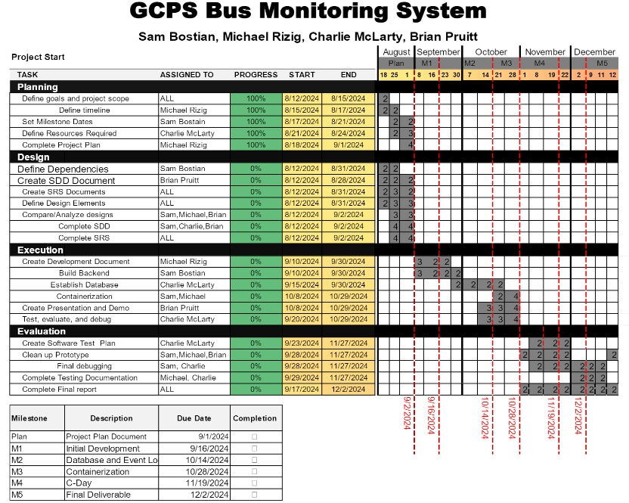
Project Plan

Slide 11
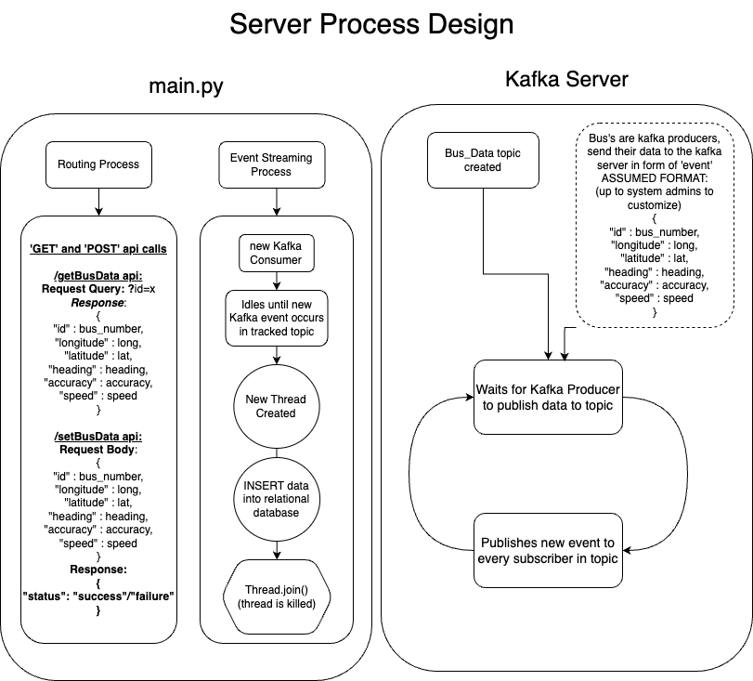
Design

Slide 12
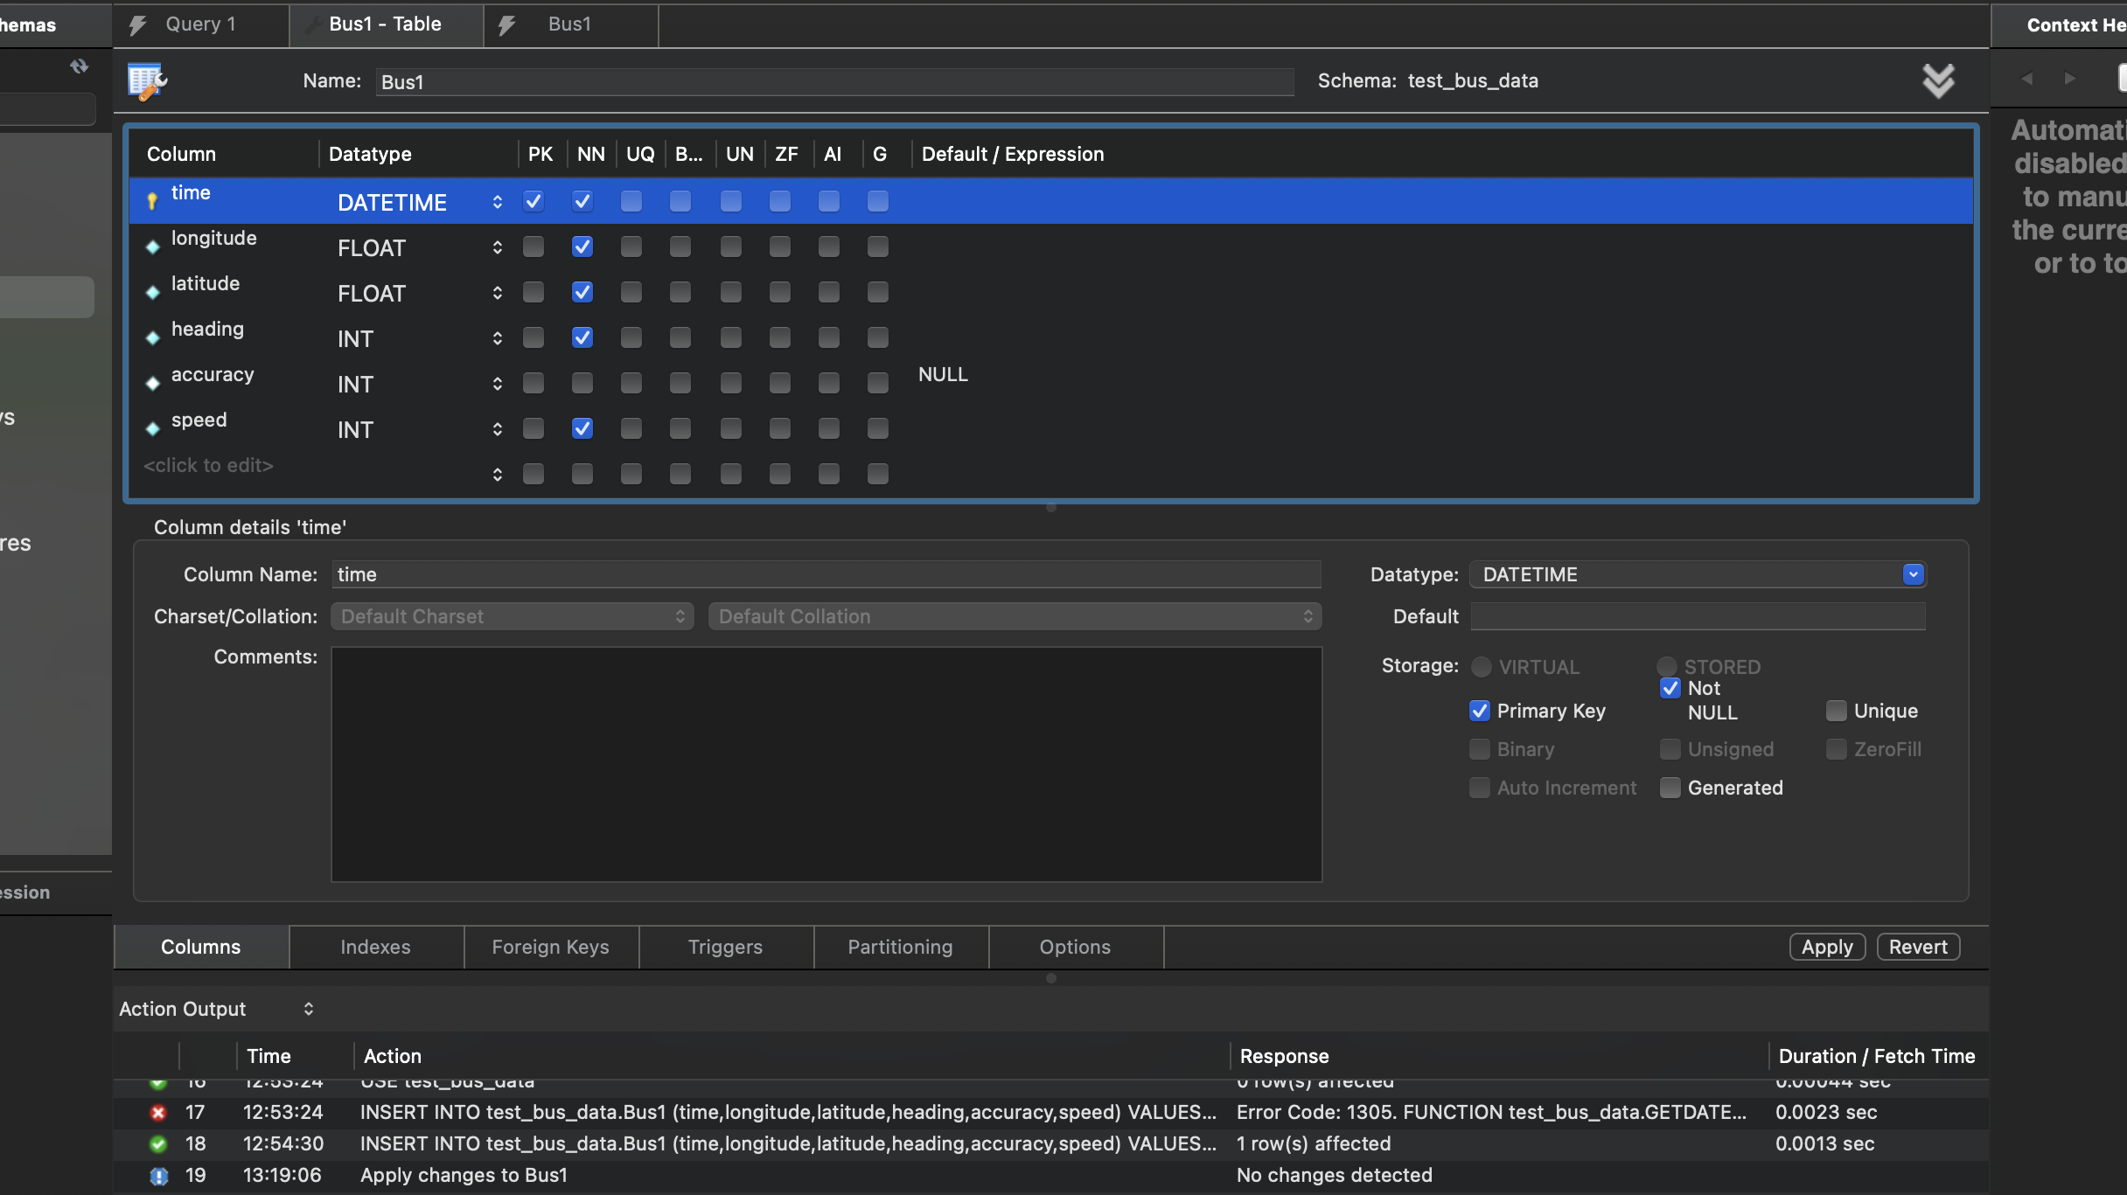
Database Schema

Slide 13
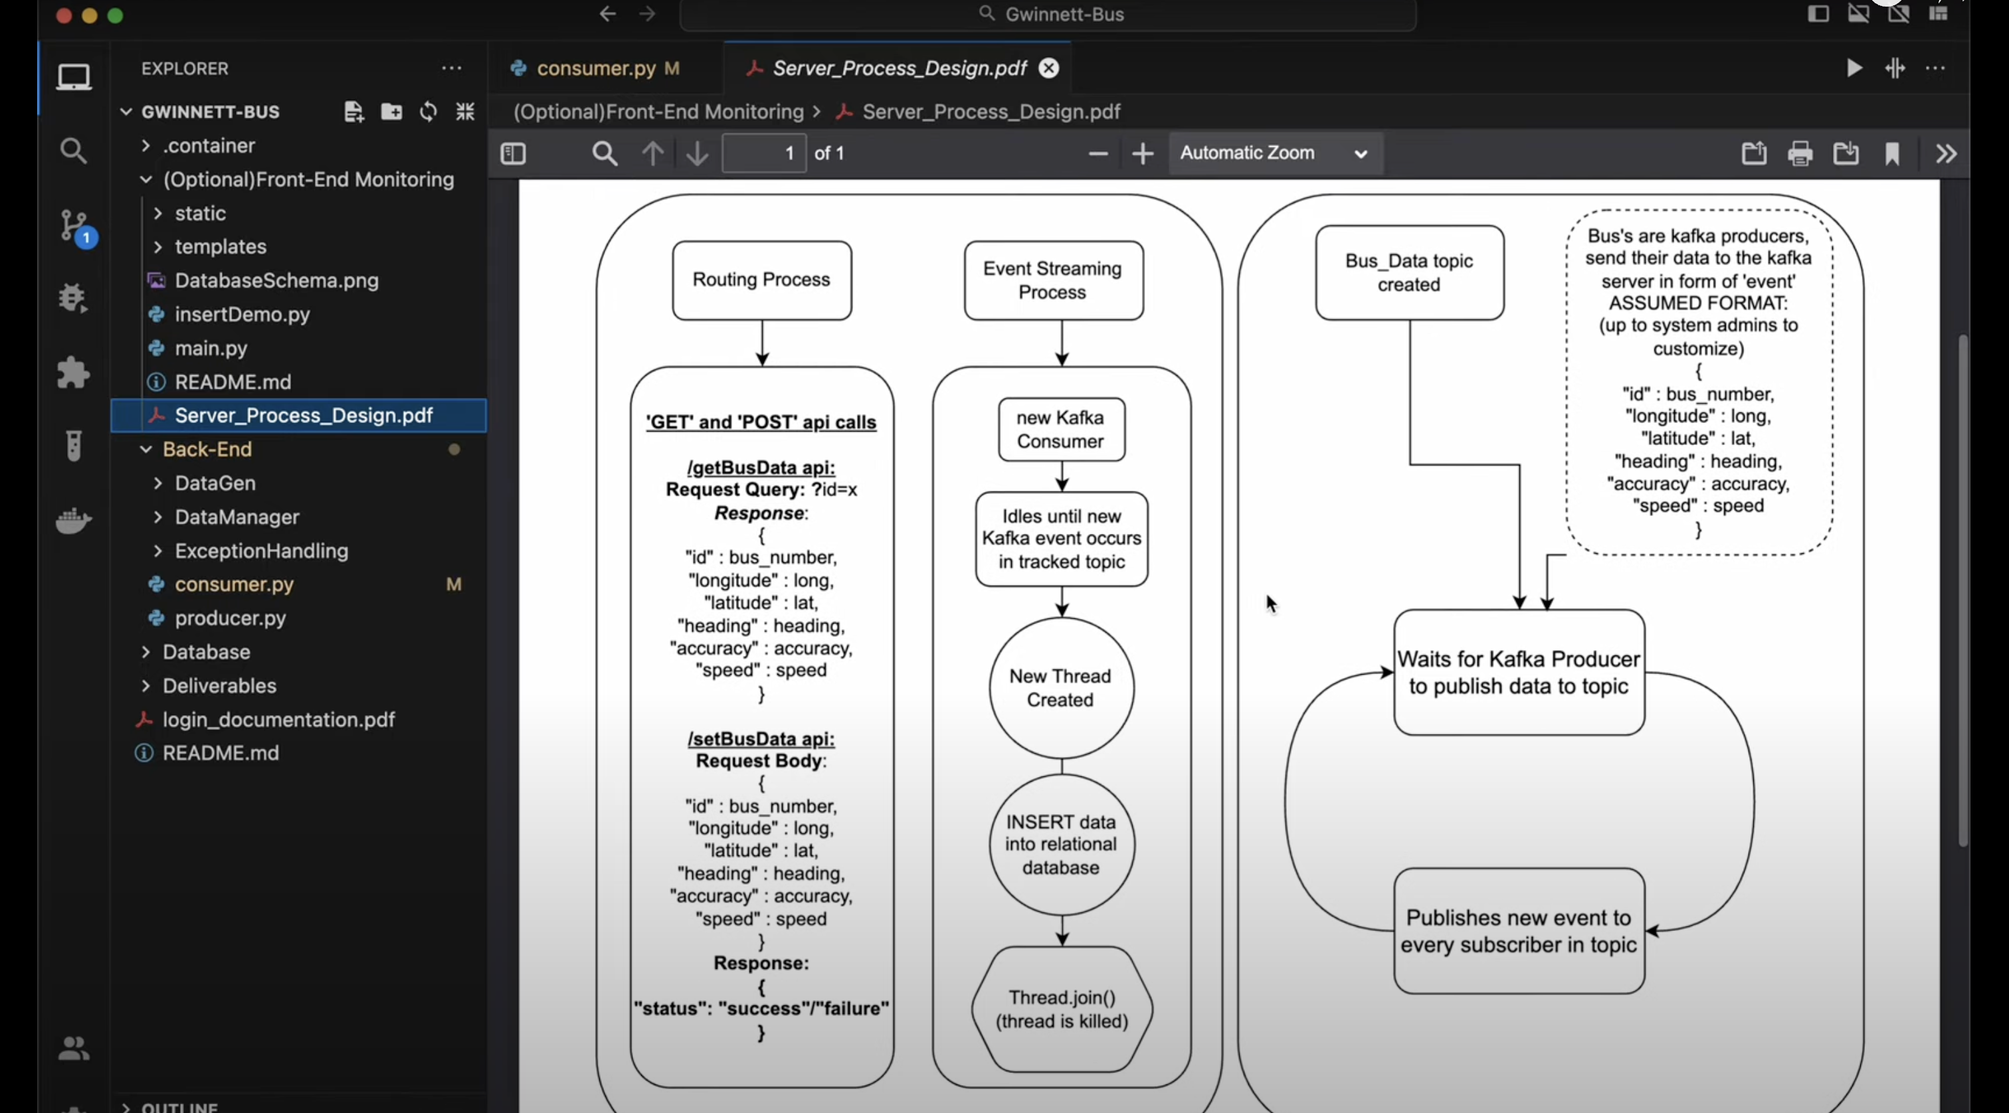
Kafka Demo
A quick demo of Kafka Event Streaming and working Producer – Consumer data transfer. This demo is a proof of concept for the proposed Kafka Server functionality.
https://www.youtube.com/watch?v=6ksd_NNYk3Y&t=1s&ab_channel=MichaelRizig

Slide 14
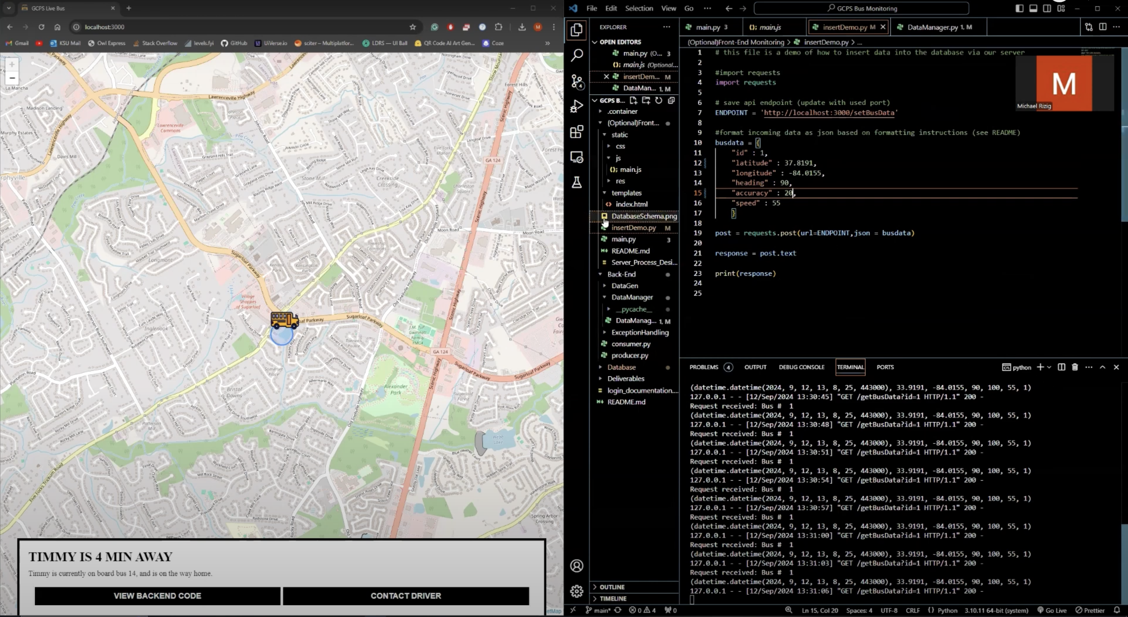
Database Demo
A quick demo of database insertion, conditional queries with Microsoft SQL, as well as full stack communication via HTTPS requests with params for updated database records.
https://www.youtube.com/watch?v=haKVglFf_5U&ab_channel=MichaelRizig

